Slide 1
AI-Powered Interactive Learning Assistant for Classrooms
Team Name : Pinnacle
Team Members: Navyashree J
A Swathi
H Sahana

Slide 2
Project Vision and Objectives
Vision: To transform traditional classrooms into intelligent, interactive learning environments using AI to enhance student engagement, personalize learning experiences, and support teachers in real-time.
Objectives: Facilitate real-time student-teacher interaction through voice or text-based Q&A. Enable adaptive learning based on individual student performance and behavior. Provide instant answers, explanations, and feedback using AI. Automate repetitive tasks for teachers like quiz creation and attendance tracking. Foster inclusive learning for students with different learning speeds and styles.

Slide 3
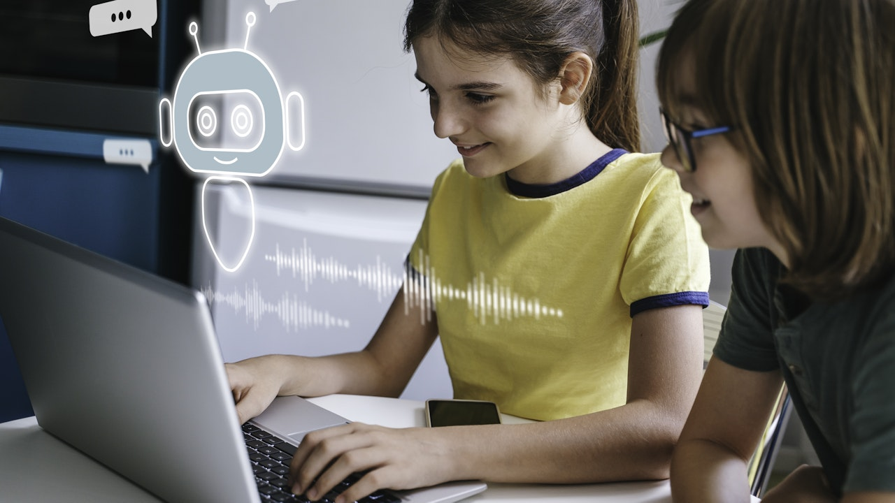
The Problem / Need
Lack of personalized attention: One teacher cannot cater to all student needs in a classroom of 30–50+ students.
Student hesitation: Many students are shy or hesitant to ask questions during class.
Overloaded teachers: Teachers face time problems in grading, content creation, and monitoring student progress.
Engagement gap: Traditional learning methods lack interactivity and real-time support.
Equity in learning: Not all students have the same pace of understanding, leading to learning gaps.

Slide 4
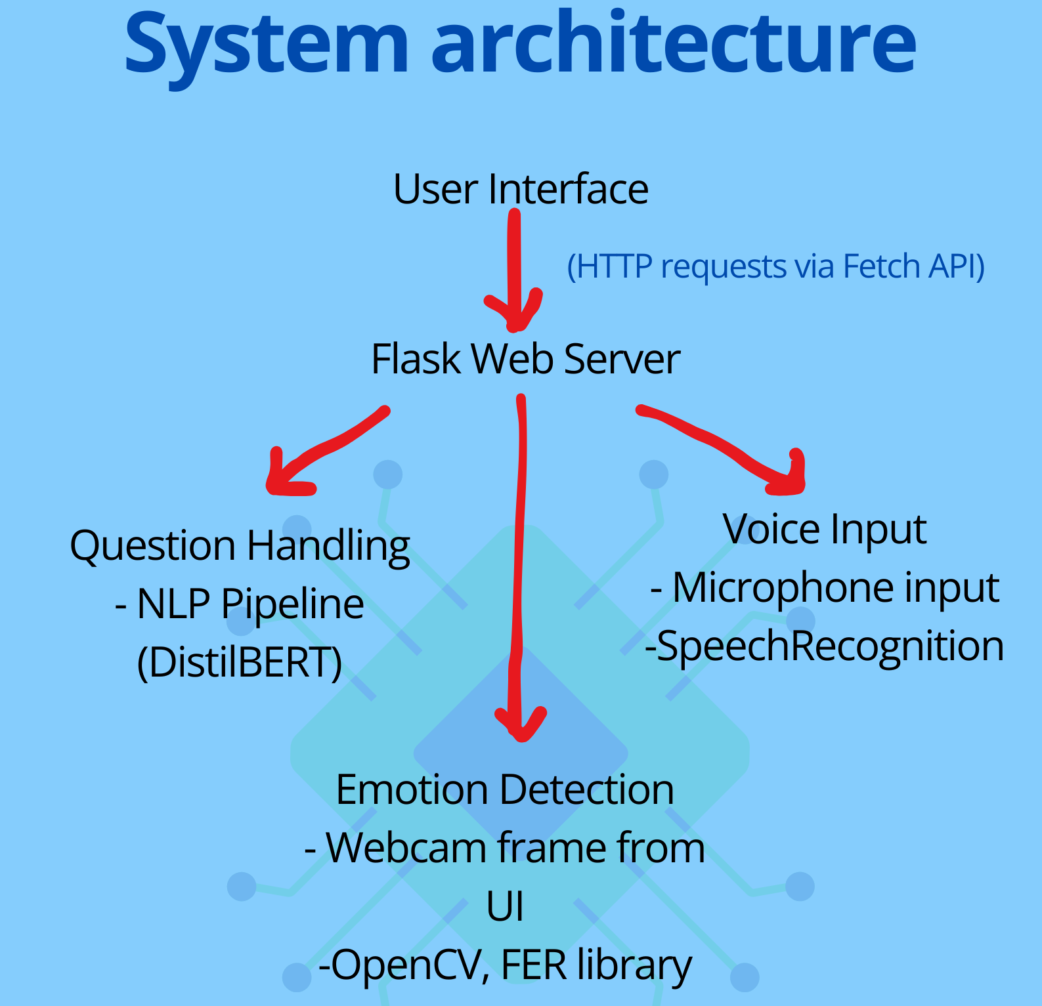
SYSTEM ARCHITECTURE

Slide 5
CORE MODULE-TEXT QUESTION ANSWERING
Context-Aware Question Answering
Model: distilbert-base-uncased-distilled-squad (Hugging Face)
Function: Extracts answers from provided content (e.g., lecture notes, textbook)
Use Case: Students ask questions based on specific study materials.
General Knowledge Fallback
Function: Answers common questions when no context is given or the model can’t find a clear answer.
Example: "What is AI?”

Slide 6
Other Key Modules and Technologies
Voice input model : uses library SpeechRecognition , pyaudio
Emotion detection : uses libraries OpenCV, TensorFlow
Flask web application: uses Flask framework
Frontend UI : HTML, JavaScript
NLP Model : transformers from hugging face

Slide 7
CURRENT STATUS
The AI assistant is operational using a terminal interface, allowing users to interact through:
Text-based question
Input Voice-based question
Input Image analysis
Webcam-based engagement monitoring
A functioning contextual question-answering module is active.
Users can manually set context, or the system can answer predefined/general knowledge questions.
A basic web app interface can be launched from the terminal.

Slide 8
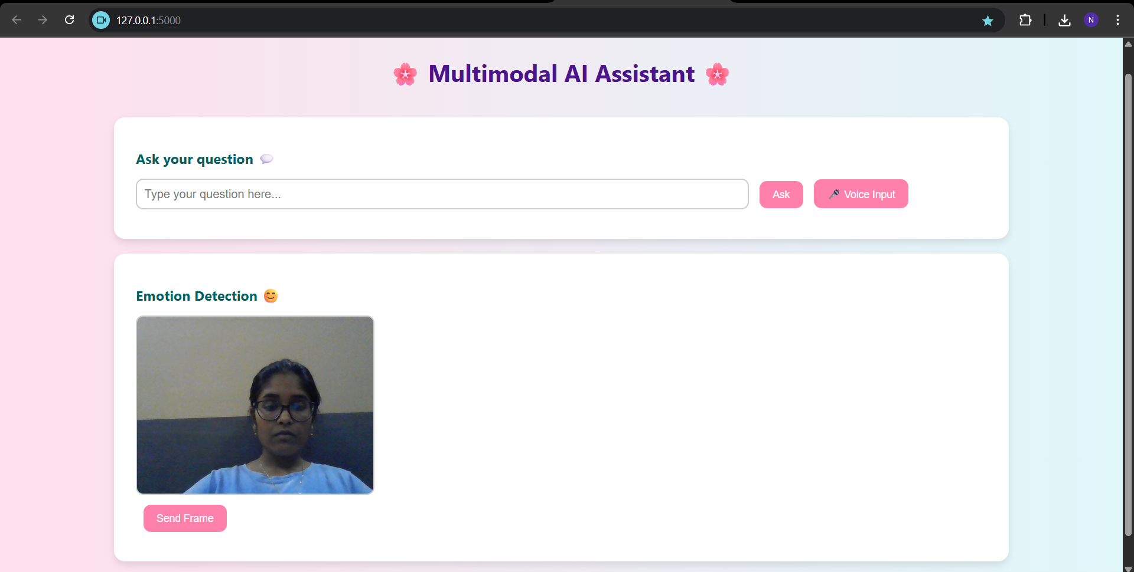
CURRENT STATUS

Slide 9
AI Assistant Development Roadmap
Immediate Goals : Visuals Aids for better undersatnding
Long-Term Vision
Introduce Visual Question Answering (VQA): Enable the system to answer questions about images (e.g., diagrams, graphs, science visuals).
LMS Integration: Seamlessly connect with platforms like Moodle, Google Classroom, or Canvas for full academic workflow support.
Personalized AI Learning: Incorporate memory so the assistant remembers user behavior, topics of interest, and learning history.

Slide 10
CHALLENGES FACED
Accuracy: Ensuring AI answers are correct and contextually appropriate.
Voice Recognition: Difficulty understanding accents and noisy environments.
Hardware issues
Server management issues
Face recognition : Hard to recognize accurately due to environment or camera quality

Slide 11
Conclusion
We have built an intelligent classroom assistant capable of understanding and responding through text, voice, and visual inputs.
It offers personalized, support to students if enhanced, enriching the learning experience and promoting active engagement.
Key modules—such as question answering, speech interaction, and basic visual processing—are already operational.
Our next steps involve introducing engagement detection, refining the user interface, and optimizing performance using model acceleration techniques.

